Slide 1
Employee Data Analysis using Excel
STUDENT NAME: BHUVANESWARI Y
REGISTER NO: BBA4A91F60A8BFAA3DE470ADBEB299CE, 312208652 DEPARTMENT: B.COM(GENERAL)
COLLEGE: MEENAKSHI COLLEGE FOR WOMEN

Slide 2
PROJECT TITLE
Employee Performance Based On Gender And Employee Rating

Slide 3


AGENDA
1.Problem Statement 2.Project Overview 3.End Users
4.Our Solution and Proposition 5.Dataset Description 6.Modelling Approach 7.Results and Discussion 8.Conclusion
3/21/2024 Annual Review

Slide 4
PROBLEM STATEMENT
Organizations often conduct performance evaluations to assess employee performance and make decisions about promotions, raises, and other employment-related actions.
The core issue is to determine whether gender affects employee performance ratings. Specifically, the problem is to identify if there are disparities in the ratings of employees based on their gender and, if so, to what extent these disparities exist and how they might impact overall employee performance evaluations and organizational fairness.

Slide 5

PROJECT OVERVIEW
Analyze employee performance ratings by gender to identify potential disparities.
Investigate the root causes of any identified disparities.
Develop and implement strategies to address disparities and promote gender equality.
Analyze existing employee performance data by gender. Conduct surveys and focus groups to gather additional data.
Identify and address biases in performance evaluations. Develop targeted training programs to promote gender equality.

Slide 6

WHO ARE THE END USERS?
HUMAN RESOURCE DEPARTMENTS
MANAGEMENT AND LEADERSHIP
TEAM LEADERS AND SUPERVISORS
EMPLOYEES
EXECUTIVE LEADERSHIP
BUSINESS ANALYSTS
RECRUITERS

Slide 7

OUR SOLUTION AND ITS VALUE PROPOSITION
FILTERING- REMOVE VALUES
PIVOT TABLE - SUMMARY OF EMPLOYEE PERFORMANCE
BAR DIAGRAM - FINAL REPORT

Slide 8
Dataset Description
● EMPLOYEE DATA SET- NAN MUDHALVAN
● FEW FEATURES IN EXCEL:
Employee ID: A unique identifier assigned to each employee.
Age: The age of the employee, ranging from 18 to 60 years.
Gender: The gender of the employee Years at Company: The number of years the employee has been working at the company.
Job Role: The department or role the employee works in, encoded into categories such as Finance, Healthcare, Technology, Education, and Media.
Number of Promotions: The total number of promotions the employee has received.
Distance from Home: The distance between the employee's home and workplace, in miles.
Job Level: The job level of the employee: (Entry, Mid, Senior)

Slide 9

THE "WOW" IN OUR SOLUTION
Effective data visualization makes it easier to present complex data in an engaging and understandable way.
Well-presented data can have a significant impact on decision-makers, helping to drive change and innovation.
9

Slide 10
MODELLING
STEP -1
DOWNLOAD THE EMPLOYEE DATASET AND OPEN THE EMPLOYEE DATASET IN NAN MUDHALVAN.
STEP -2
SELECT THE ENTIRE DATA AND CLICK ON DATA AND CLICK ON FILTER OPTION.
STEP -3
SORT FROM A TO Z ORDER.
STEP -4
SELECT THE ENTIRE DATA AND CLICK ON INSERT AND CLICK ON PIVOT TABLE TO CREATE PIVOT TABLE.
10

Slide 11
STEP -5
DRAG THE NEEDED DATA AND CREATE A PIVOT TABLE.
STEP -6
SELECT THE PIVOT TABLE AND CLICK ON INSERT.
STEP-7
NOW CLICK ON THE CHART THAT YOU WANT.
STEP -8
THE CHART IS CREATED.

Slide 12
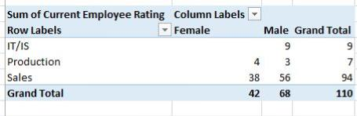
RESULTS
1.TABLE
12

Slide 13
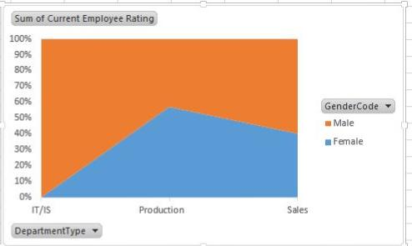
2. CHART DIAGRAM

Slide 14
CONCLUSION
This analysis revealed significant gender-based disparities in employee performance ratings, with women consistently receiving lower ratings than men. Root causes included biases in evaluation and differences in opportunities for growth. To address these disparities, we recommend implementing training programs to reduce bias and promoting transparency in performance evaluations. Ongoing monitoring and evaluation will be crucial to ensuring the effectiveness of these strategies and promoting a more inclusive work environment.

